Slide 1
USCB Registrar System
By Group 12 (Jacob Mitchell and Michael Murray)

Slide 2
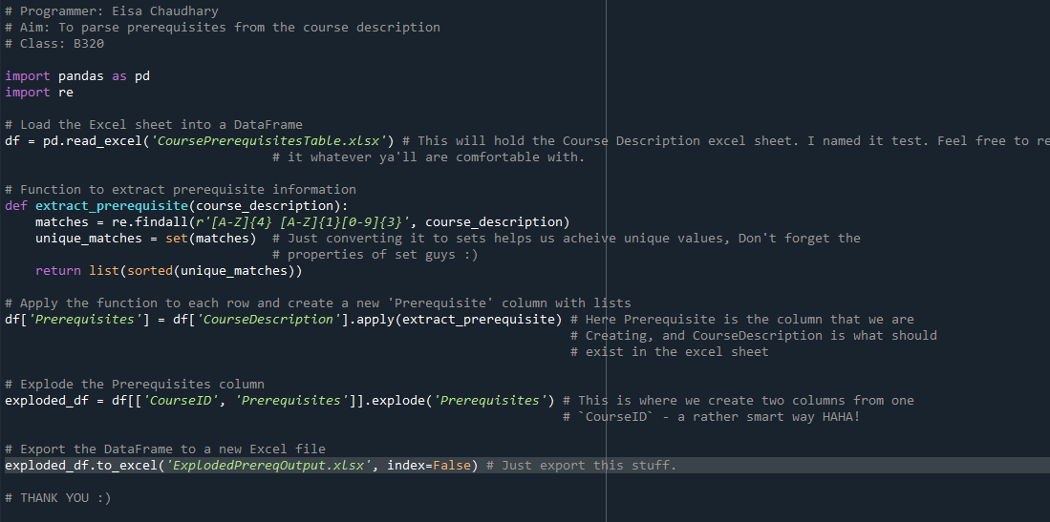
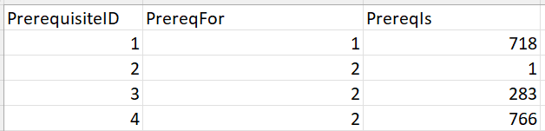
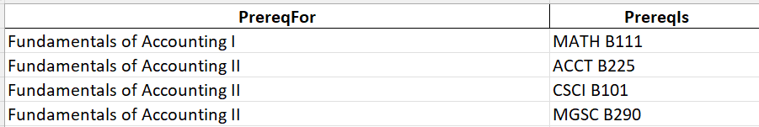
Prerequisite Parsing
We used Eisa’s code to parse out the prerequisites. Once we got the file, we changed the names of the courses to their corresponding ID from our Course Catalog Table. One set for our target course (PrereqFor) and another for the prerequisite of our target course (PrereqIs).
C:\Users\mikem\OneDrive\Documents\prerequisitesParser.py

Slide 3

Favorite Part & Lesson Learned
This project has instilled in me a considerable amount of patience.
I learned through this project that you can’t procrastinate on everything in life.
My favorite part of this project was figuring out solutions to problems and getting my inserts to work in particular. It felt like an accomplishment to find a solution to a problem that doesn’t have a straightforward solution.
I have learned how to work through complex problems by breaking down the issue into smaller parts to come up with a solution.

Slide 4


